Slide 1
Spring Boot
Dog Rescue: Create database schema

Slide 2
What's in this video?
Create the Entity Relationship Diagram (ERD)
Create the schema, user, password, and privileges in MySQL Workbench

Slide 3
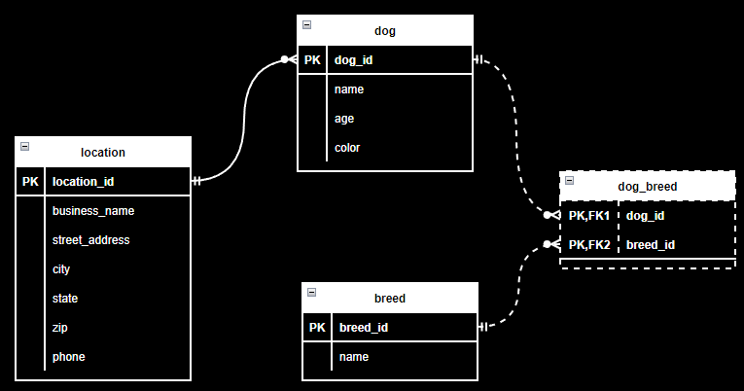
Create the Entity Relationship Diagram

Slide 4
Create schema and user
Use MySQL Workbench
Free tool that comes with MySQL Community Edition

Slide 5
Let's do it!

